Slide 1
A Framework for Text Categorization
Ken Williams, ME(R), University of Sydney
Rafael Calvo, Supervisor
August 23, 2002

Slide 2
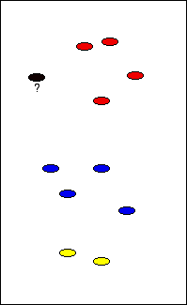
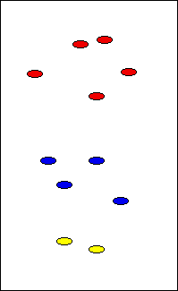
Overview
Text Categorization
AI::Categorizer Framework
Applications

Slide 3
Text Categorization
… the activity of labeling natural language texts with thematic categories from a pre-defined set
[Sebastiani, 2002]
Also called “Text Classification,” “Topic Spotting”
Subfield of Information Retrieval (sometimes)
Cross-pollinates with Computer Science, Linguistics, Mathematics, Statistics, Cognitive Science, among others

Slide 4
Text Categorization
Before 1980’s, TC was mainly only of academic interest
Before early 1990’s, TC was primarily a Knowledge Engineering task (hand-written rules)
Modern approaches use Machine Learning (ML) to induce a categorizer from a training set

Slide 5
Text Categorization
Training set is a set of documents with near-identical statistical properties to the documents in the target domain
Adequate training data can be difficult (expensive) to gather
Some categorization tasks are more amenable to ML than others
Thus, TC is often “hard”

Slide 6
Text Categorization
Typical TC applications/buzzwords:
  Data Mining
  Knowledge Management (KM)
  Information Retrieval (IR)
  Expert Systems
  Topic detection and tracking
Related ML fields:
  Clustering
  Recognition
  Filtering

Slide 7
Framework Design
Why create a TC framework?
Two main TC groups: research and industry
These groups do listen to each other, a little
Still, not many reusable TC components, outside of a few commercial systems
  Researchers tend to emphasize results over products
  Industry developers tend to create ad-hoc solutions to their own problems - these don’t generalize
  Generic commercial systems are expensive
This leaves TC inaccessible to the rest of us

Slide 8
Framework Design
What is a framework?
Hierarchy of Object-Oriented (OO) classes providing reusable, customizable solutions to generic problems
More structured than libraries, more concrete than patterns
Frameworks can be combined to make larger frameworks or applications
  Example: an email application may use a messaging framework, a windowing framework, a text categorization framework, and an application framework

Slide 9
Framework Design
General design requirements
  Customizable
  Broadly applicable (with people actually using it)
  Interfaces easily with existing TC solutions
  Interfaces easily with other frameworks/tools
  Rapid application development
  Rapid research cycle
  Separable component design
  Open license terms

Slide 10
Framework Design
Supports customization, with reasonable defaults, of TC considerations:
  Document format
  Document structure
  Tokenizing
  Stemming
  Feature selection
  Feature extraction
  Vectorization transformations (e.g. TF/IDF)
  Machine Learner selection/configuration
  Hypothesis behavior (single-label, multi-label, scoring…)

Slide 11
Framework Design
Support many use-cases:
  Single-label vs. multi-label categorization
  Single-document vs. batch operations
  “Hard” vs. rank-based categorization
  Client-server vs. monolithic applications
  Text vs. non-text data
  Start-to-finish vs. saved-state scenarios
  On-line vs. batch training

Slide 12
Framework Design
Support many use-cases:
  Single-label vs. multi-label categorization
  Single-document vs. batch operations
  “Hard” vs. rank-based categorization
  Client-server vs. monolithic applications
  Text vs. non-text data
  Start-to-finish vs. saved-state scenarios
  On-line vs. batch training

Slide 13
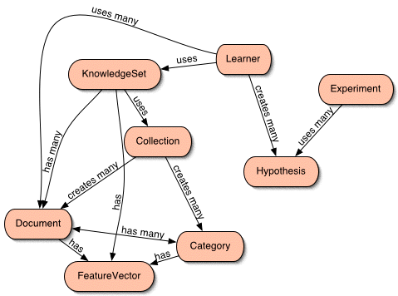
AI::Categorizer Framework

Slide 14
AI::Categorizer Framework
KnowledgeSet embodies a set of documents and categories

Slide 15
AI::Categorizer Framework
Document is a (possibly structured) set of text data, belonging to 1 or more categories

Slide 16
AI::Categorizer Framework
Category is a named set containing 1 or more documents

Slide 17
AI::Categorizer Framework
Collection is a storage medium for document and category information (as text files, in DBI, XML files, etc.)

Slide 18
AI::Categorizer Framework
Feature Vector maps features (words) to weights (counts)

Slide 19
AI::Categorizer Framework
Learner is a ML algorithm class (Naïve Bayes, kNN, Decision Tree, etc.)

Slide 20
AI::Categorizer Framework
Hypothesis is the learner’s “best guess” about document categories

Slide 21
AI::Categorizer Framework
Experiment collects and analyzes hypotheses

Slide 22
Using AI::Categorizer
Highest-level interface
use AI::Categorizer;
my $c = new AI::Categorizer(...parameters...);
# Run a complete experiment - training on a
# corpus, testing on a test set, printing a
# summary of results to STDOUT
$c->run_experiment;

Slide 23
Using AI::Categorizer
More detailed:
use AI::Categorizer;
my $c = new AI::Categorizer(...parameters...);
# Run the separate parts of $c->run_experiment
$c->scan_features;
$c->read_training_set;
$c->train;
$c->evaluate_test_set;
print $c->stats_table;

Slide 24
Using AI::Categorizer
In an application:
# After training, use learner for categorizing
my $l = $c->learner;
while (...) {
my $d = ...create a document...
my $h = $l->categorize($d);
print "Best category: ", $h->best_category;
}

Slide 25
Using AI::Categorizer
Uses the Class::Container package, so all parameters can go to the top-level object constructor:
my $c = new AI::Categorizer
(progress_file => 'my_progress',
data_root => 'my_data',
features_kept => 10_000,
threshold => 0.1,
);

Slide 26
Using AI::Categorizer
Uses the Class::Container package, so all parameters can go to the top-level object constructor:
my $c = new AI::Categorizer
(progress_file => 'my_progress',
data_root => 'my_data',
features_kept => 10_000,
threshold => 0.1,
);
(AI::Categorizer needn’t know about these, it’s transparent)
To Categorizer
To KnowledgeSet
To Learner

Slide 27
Sample Applications
Simple command-line wrapper application
Client-server GUI application (by Mark Aufflick)

Slide 28
Selected References
Fabrizio Sebastiani, Machine Learning in Automated Text Categorization. ACM Computing Surveys, Vol. 34, No. 1, March 2002, pp.1-47.
Chris Manning & Hinrich Schütze, Foundations of Statistical Natural Language Processing. MIT Press, 1999.
Tom Mitchell, Machine Learning. McGraw-Hill, 1997, 414pp.
Yiming Yang & Xin Liu, A re-examination of text categorization methods. Proceedings of SIGIR, 1999.
Mohamed Fajad, & Douglas Schmidt, & Ralph Johnson, Building Application Frameworks. Wiley Computer Publishing, 1999, 688pp.

